Slide 1
The Gas Laws
3.2

Slide 2
Gas Laws
How do Pressure and Temperature affect solids, liquids and gases?
BBC - KS3 Bitesize Science - Behaviour of matter :

Slide 3
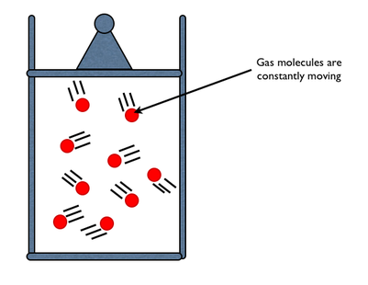
How do gas molecules behave?

Slide 4
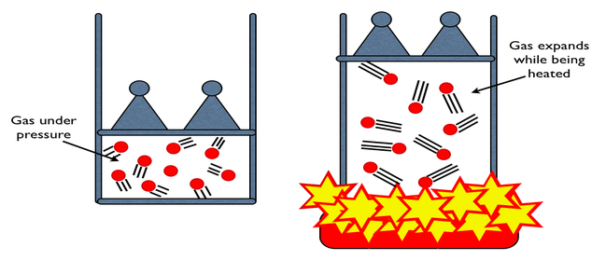
Can you describe what is happening here?

Slide 5
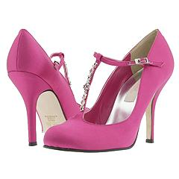
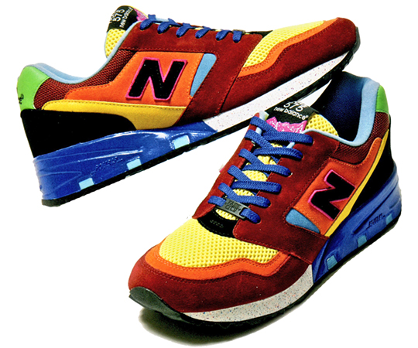
Pressure
Questions 1 + 2
The result of a force distributed over an area
Objects of all sizes can exert pressure when it collides with something else

Slide 6
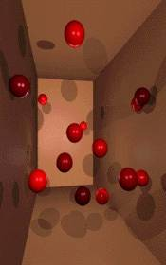
Pressure – What causes it in a closed container?
Questions 3 + 4
Collisions between particles of a gas and the walls of the container cause the pressure in a closed container of gas
The more frequent the collisions the greater the pressure of the gas

Slide 7
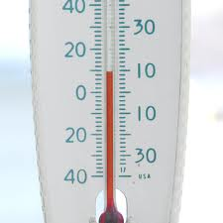
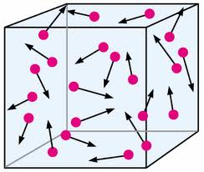
Factors affecting gas pressure
Question 5
3 factors can affect the pressure of an enclosed gas
  Temperature
  Volume
  Number of particles

Slide 8
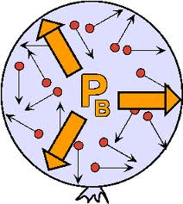
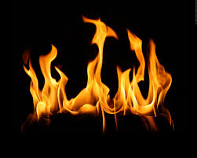
Temperature
Question 6
Raising the temperature of a gas will increase its pressure if the volume and number of particles are constant or same

Slide 9
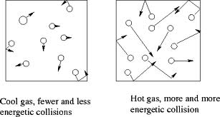
Temperature
Why is that?
The higher the temperature the faster the particles are moving and hitting the walls of the container
They have more Kinetic energy..!!!!

Slide 10
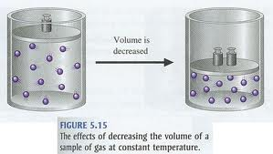
Volume
Question 7
Reducing the volume of a gas increases its pressure if the temperature and number of particles are constant.
What is Volume?
The amount of space object/gas molecules take up
nmnmnmnmnmnmn

Slide 11
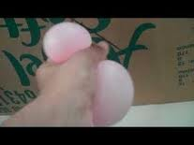
Volume- what caused the volume of balloon to change?
Question 8
As you are pressing down on the balloon the volume of the balloon gets smaller
Gas molecules are hitting the inside of the balloon more frequently
This causes more pressure inside it the balloon..

Slide 12
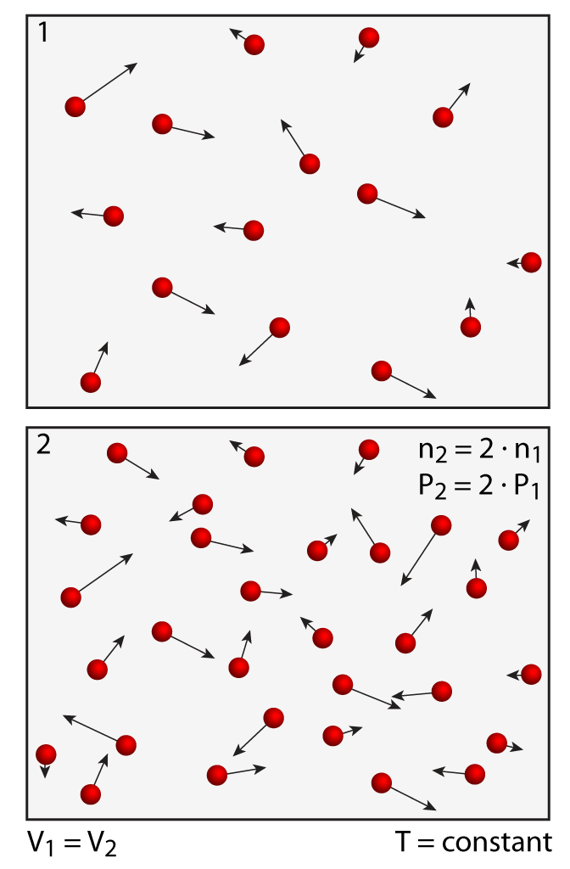
Number of particles
Question 9
Increasing the number of particles will increase the pressure of a gas if the temperature and the volume are constant

Slide 13
There are two important Laws that explain the behavior of gases
Boyle’s Law
Charles’s Law

Slide 14
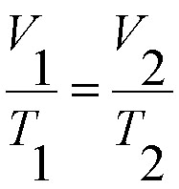
Charles’s Law
Questions 10 + 11
The volume of a gas is directly proportional to its temperature in Kelvins if the pressure and number of particles of the gas are constant
In other words….If the temperature increase so does the volume

Slide 15
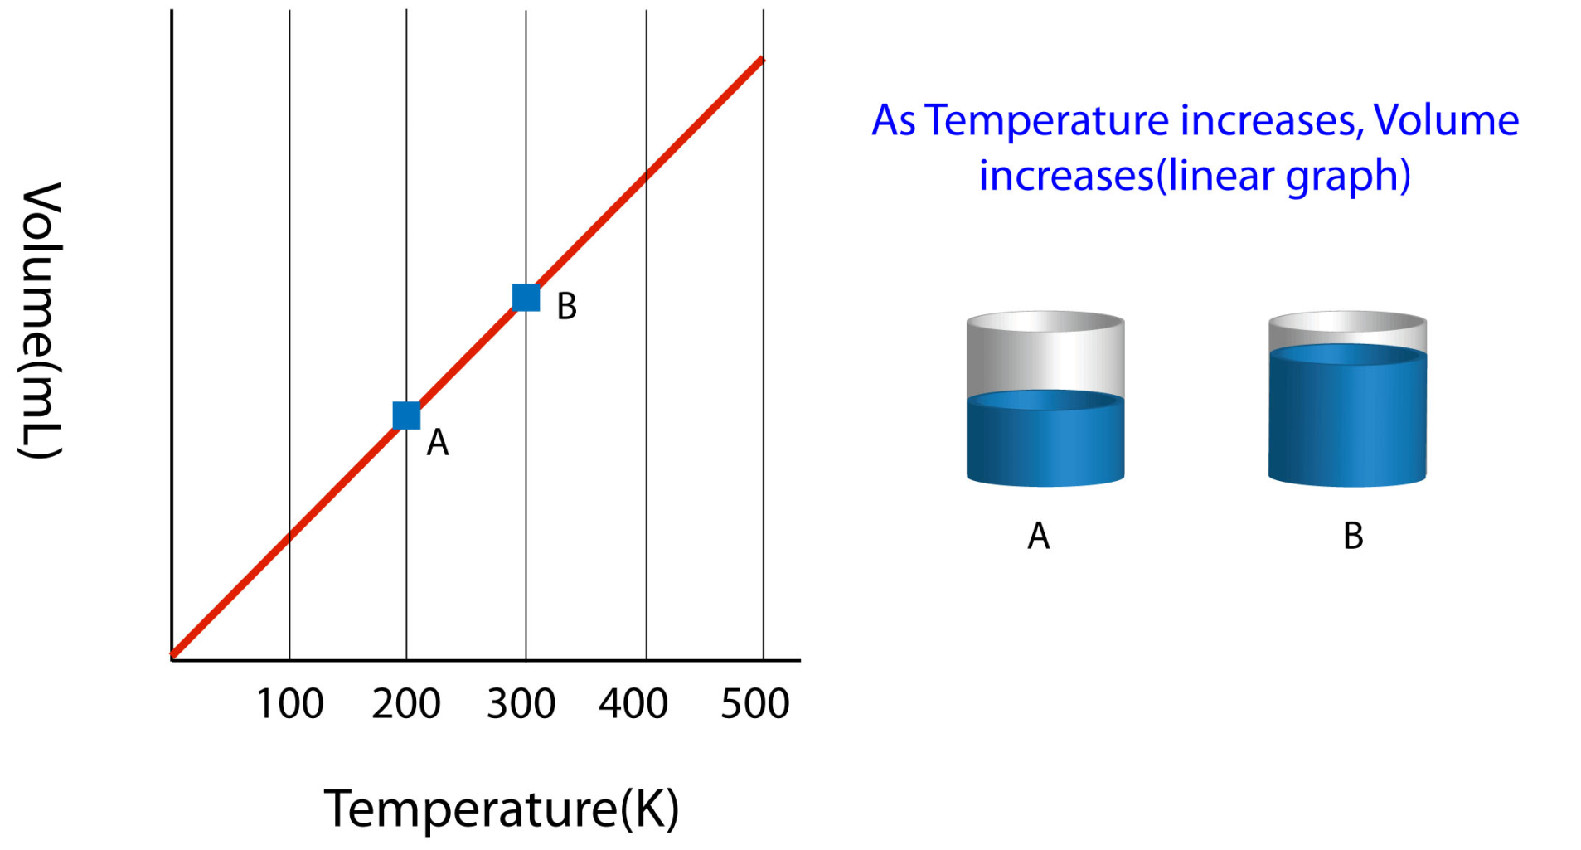
Charles’s Law
Question 12
As the temperature increased from 200 to 300K so did the volume the gas molecules take up

Slide 16
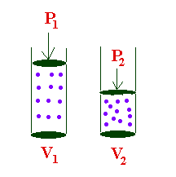

Boyle’s Law
Questions 13 + 14
The volume of a gas is inversely proportional to its pressure if the temperature and the number of particles are constant

Slide 17
Boyle’s Law
So…..if the temperature and number of particles are the same….. then as the pressure is increased, the volume of the gas particles will decrease or get smaller
When one increases…the other will decrease

Slide 18
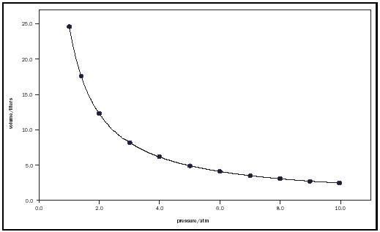
Boyle’s Law
Question 15
Volume
Pressure
As the pressure increases the volume will start decreasing

Slide 19
Combined Gas Laws
The relationship between Boyle’s and Charle’s
laws can be described in a single law :
Combined Gas Law
It is the relationship among the temperature,
volume and pressure of gas if the number of
particles remains the same/constant.
P₁V₁ / T₁ = P₂V₂ / T₂
Pressure is measured in units called
_{kiloPascal or kPa}

Slide 20
Demonstrations of the 2 laws http://www.youtube.com/watch?v=3KLiuawPBas&list=PLF7CE5603AB9EBAD0&safe=active
Demonstration of this Law

Slide 21
Review Questions
How do gas molecules behave?
They are constantly moving in random motion
What is pressure?
The result of a force distributed over an area
What do the collisions between particles of a gas and the walls of the container cause?
They create pressure
What can temperature, volume and the number of particles cause in an enclosed gas?
They can affect the pressure of the gas

Slide 22
Review Questions
5. How will raising the temperature affect the pressure if the volume and # of particles stays the same?
It will increase the pressure of the gas
6. Why does higher temperature increase the pressure?
Because the particles are moving faster and hitting the walls of the container
They have more Kinetic energy..!!!!
Reducing the volume of a gas increases its pressure if the temperature and number of particles are constant. TRUE OR FALSE
TRUE

Slide 23
Review Questions
8. What can increase the pressure of a gas if the temperature and the volume are constant ?
Increasing the number of particles
Describe Charles’s Law
The volume of a gas is directly proportional to its temperature in Kelvins if the pressure and number of particles of the gas are constant
10. In other words in Charle’s Law…….If the________________ increases so does the volume
Temperature

Slide 24
Review Questions
What is the formula for Charle’s Law?
Describe Boyle’s Law
The volume of a gas is inversely proportional to its pressure if the temperature and the number of particles are constant
13. What is the formula for Boyle’s Law?

Slide 25
http://www.youtube.com/watch?v=CgrCFRsWMtI&safe=active

