Slide 1
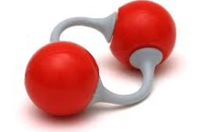
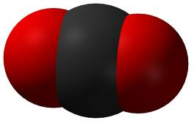
The Journey of one Oxygen and one Carbon dioxide molecule

Slide 2
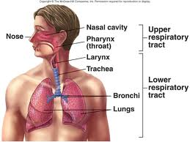
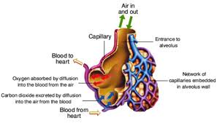
First, oxygen is inhaled mouth or nose & now travels:
Pass Epiglottis and Pharynx
Down Trachea and Bronchi
Into Bronchioles
Finally into ALVEOLI: small air sacs where oxygen diffuses into blood

Slide 3
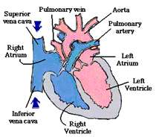
Red Blood cells pick up Oxygen
Oxygen attaches to Hemoglobin in Red Blood cell
Blood is now OXYGENATED
Oxygen travels in the Pulmonary Vein to the heart
Red: OXYGENATED Blue: DEOXYGENATED

Slide 4
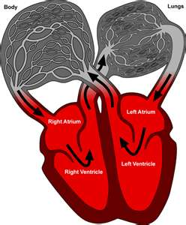
Oxygen enters the LEFT side of the heart into
Left Atrium
Then Left Ventricle- STRONGEST pump

Slide 5
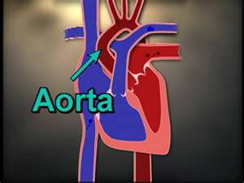
Oxygen leaves heart from left ventricle
Enters Aorta- largest artery in the body
Then into capillaries: smallest blood vessel
a. Oxygen diffuses/enters cells
b. Carbon Dioxide diffuses out of cells
Blood is now DEOXYGENATED

Slide 6
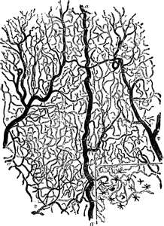
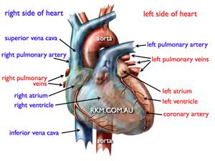
Carbon Dioxide travels back to the heart
Through Capillary
Then to Vena Cava- largest vein in the body

Slide 7
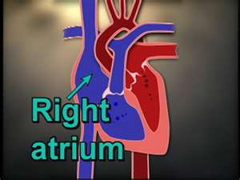
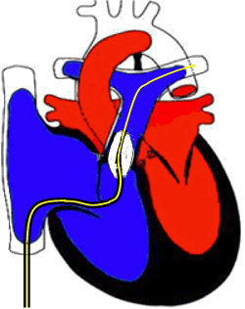
Carbon Dioxide enters the heart
Right Atrium
Right Ventricle- weakest pump

Slide 8
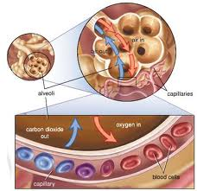
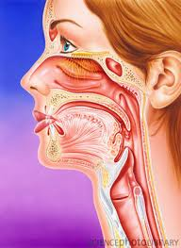
Carbon Dioxide travels back to the lungs
In Pulmonary Artery
Carbon Dioxide diffuses into Alveoli
Then into Bronchioles
Up the Bronchi and into the Trachea
Exhaled through mouth or nose

Slide 9
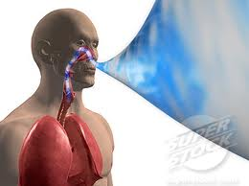
THE END

