Slide 1
Electricity and Magnetism

Slide 2
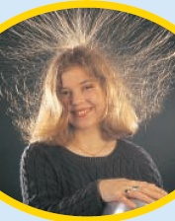
What is electricity?
The collection or flow of electrons in the form of an electric charge

Slide 3
What is static electricity?
When two objects rub against each other electrons transfer and build up on an object causing it to have a different charge from its surroundings.
Like the shoes rubbing against the carpet. Electrons are transferred from the carpet to the shoes.

Slide 4
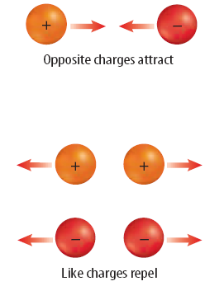
As electrons collect on an object, it becomes negatively charged. As electrons leave an object it attains a positive charges. Charges interact with each other:
Often when you remove clothes from the clothes dryer, they seem to stick together. This is because some of the clothes have gained electrons by rubbing against other clothes. The clothes losing electrons become positive. The negative clothes are attracted to the positive clothes.
Have you ever rubbed a balloon on your hair and stuck it on a wall? How do you think this works?

Slide 5
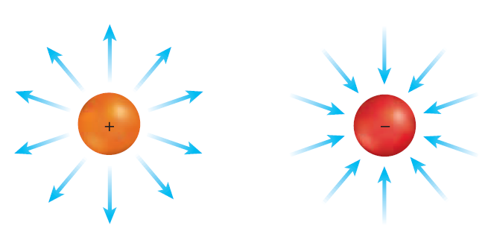
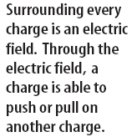

Slide 6
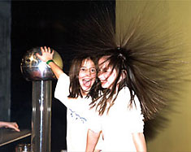
The van de Graaf generator (large silver ball) deposits electrons on the ball. When a person places their hand on the ball and the machine is turned on, electrons are transferred to and collected on the person touching the silver ball.
Why do you think this machine affects the hair of the children in the picture?

Slide 7
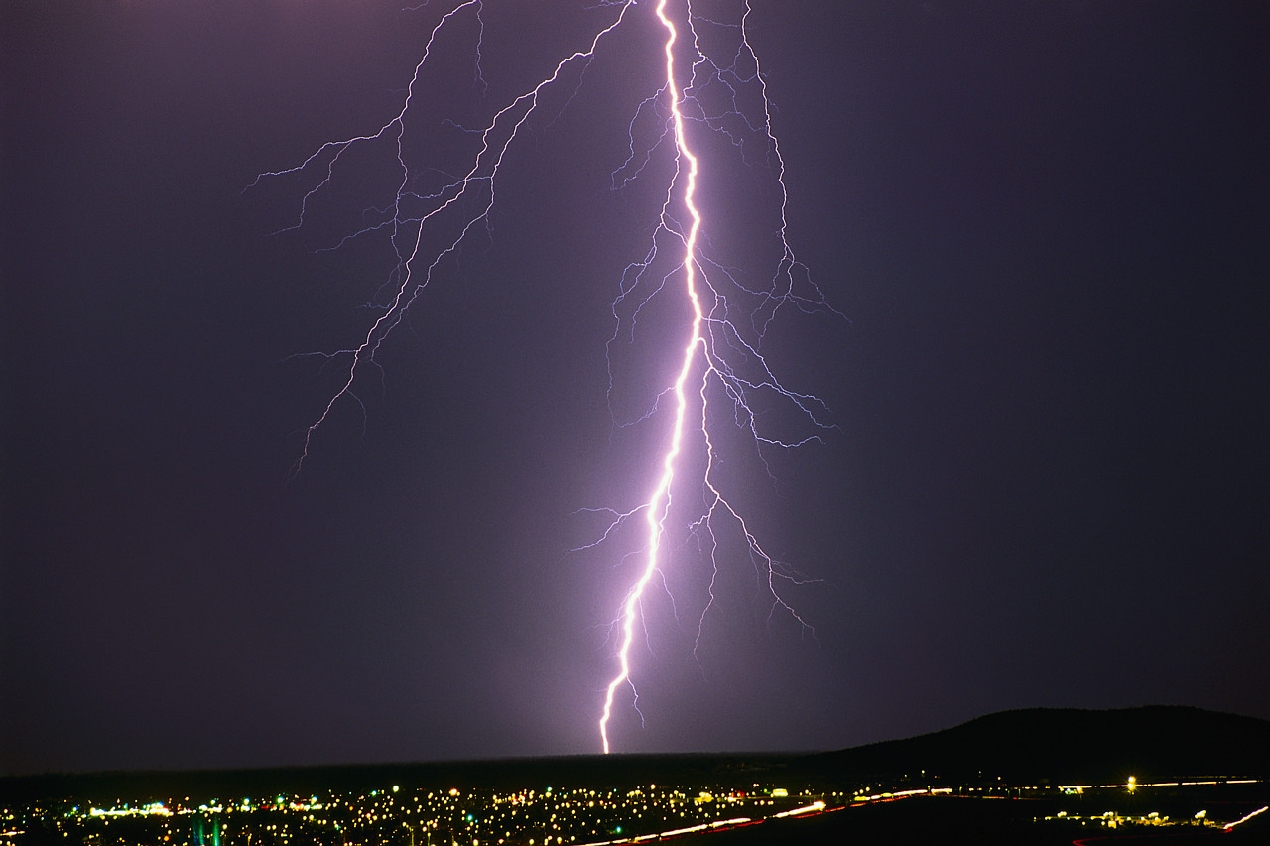
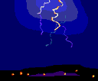
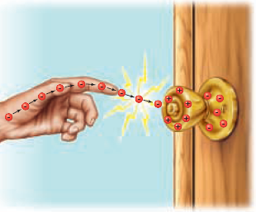
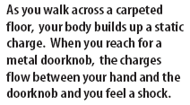
What causes you to be shocked when you rub your feet across carpet?
An electrical discharge is the passing of an electric current through the air from a negatively charged object to a positively charge object. This is what causes lightning!

Slide 8
Check out these static electricity video clips
Static electricity at a gas station
Van de Graaf Generator’s effect on human hair
Static on Baby’s hair
Kid gets static going down a slide
What is a conductor and insulator?
A conductor is a material which allows an electric current to pass. Metals are good conductors of electricity.
An insulator is a material which does not allow an electric current to pass. Nonmetals are good conductors of electricity. Plastic, glass, wood, and rubber are good insulators

Slide 9
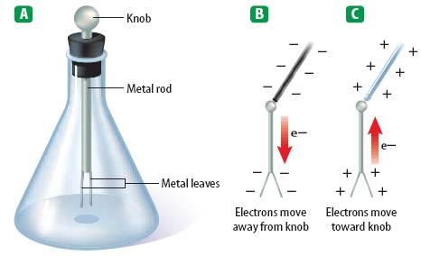
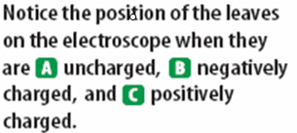
How are static charges detected?

Slide 10
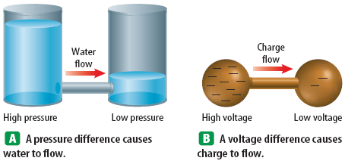
What is the difference between static electricity and current electricity?
Static electricity is stationary or collects on the surface of an object, whereas current electricity is flowing very rapidly through a conductor.
The flow of electricity in current electricity has electrical pressure or voltage. Electric charges flow from an area of high voltage to an area of low voltage.
Water pressure and voltage behave in similar ways.

Slide 11
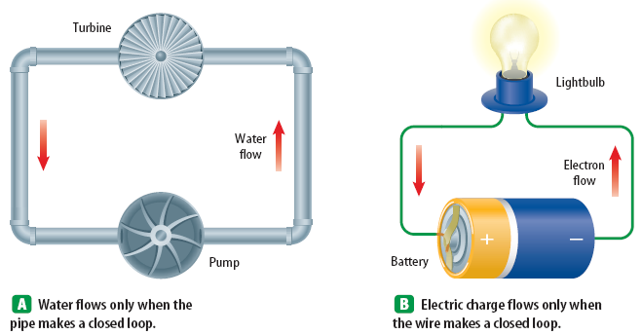

Slide 12
The pressure of the water flowing through the pipes on the last slide compare to the voltage (electric potential) flowing through the wires of the circuit.
The unit used to measure voltage is volts (V).
The flow of charges in a circuit is called current.
Current (I) is measured in Amperes (A).

Slide 13
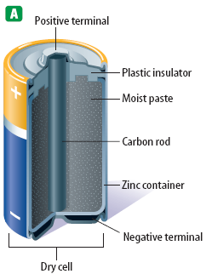
What are batteries?
Batteries are composed of a chemical substance which can generate voltage which can be used in a circuit.
There are two kinds of batteries: dry cell and wet cell batteries. Below is an example of a dry cell.
The zinc container of the dry cell contains a moist chemical paste surrounding a carbon rod suspended in the middle.

Slide 14
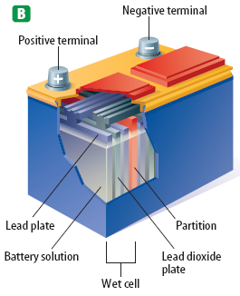
Wet cell batteries are most commonly associated with automobile batteries.
A wet cell contains two connected plates made of different metals or metal compounds in a conducting solution. Most car batteries have a series of six cells, each containing lead and lead oxide in a sulfuric acid solution.

Slide 15
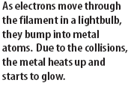
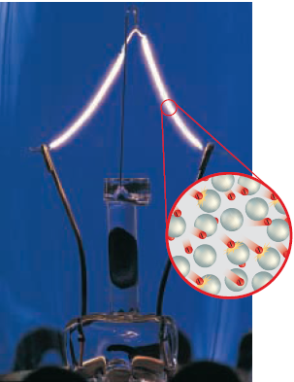
What is electrical resistance?
Resistance (R)is the opposition to the flow of an electric current, causing the electrical energy to be converted to thermal energy or light.
The metal which makes up a light bulb filament or stovetop eye has a high electrical resistance. This causes light and heat to be given off.

Slide 16
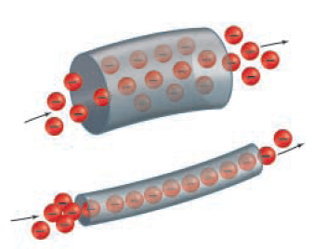
The unit for measuring resistance is the ohm (Ω).

Slide 17
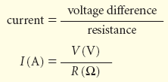
Electrical Calculations – What is Ohm’s Law?
3 V
I = 1.5 amps
I =
2 Ω

Slide 18
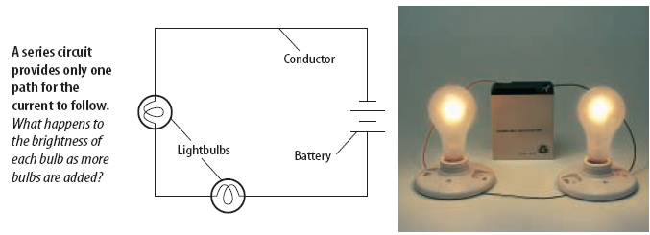
What are electric circuits?
Circuits typically contain a voltage source, a wire conductor, and one or more devices which use the electrical energy.
What is a series circuit?
A series circuit is one which provides a single pathway for the current to flow. If the circuit breaks, all devices using the circuit will fail.

Slide 19
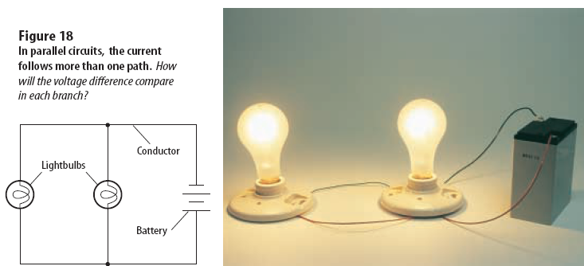
What is a parallel circuit?
A parallel circuit has multiple pathways for the current to flow. If the circuit is broken the current may pass through other pathways and other devices will continue to work.

Slide 20
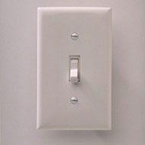
What is the difference between an open circuit and a closed circuit?
A closed circuit is one in which the pathway of the electrical current is complete and unbroken.
An open circuit is one in which the pathway of the electrical current is broken. A switch is a device in the circuit in which the circuit can be closed (turned on) or open (turned off).

Slide 21
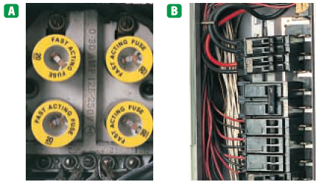
How is household wiring arranged?
Most household wiring is logically designed with a combination of parallel circuits. Electrical energy enters the home usually at a breaker box or fuse box and distributes the electricity through multiple circuits. A breaker box or fuse box is a safety feature which will open

Slide 22
How is Electrical Power calculated?
Electrical Power is the product of the current (I) and the voltage (v)
The unit for electrical power is the same as that for mechanical power in the previous module – the watt (W)
Example Problem: How much power is used in a circuit which is 110 volts and has a current of 1.36 amps? P = I V
Power = (1.36 amps) (110 V) = 150 W

Slide 23
How is electrical energy determined?
Electrical energy is a measure of the amount of power used and the time of use.
Electrical energy is the product of the power and the time.
Example problem:
E = P X time
P = I V
P = (2A) (120 V) = 240 W
E = (240 W) (4 h) = 960Wh = 0.96 kWh

Slide 24
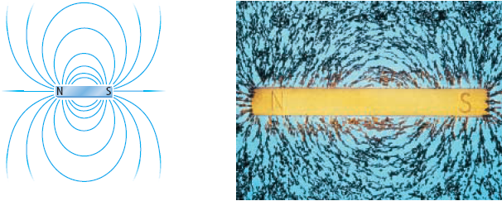
What is magnetism?
Magnetism is the properties and interactions of magnets
The earliest magnets were found naturally in the mineral magnetite which is abundant the rock-type lodestone. These magnets were used by the ancient peoples as compasses to guide sailing vessels.
Magnets produce magnetic forces and have magnetic field lines

Slide 25
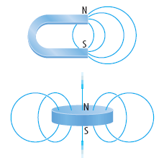
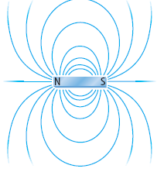
Magnets have two ends or poles, called north and south poles. At the poles of a magnet, the magnetic field lines are closer together.
Unlike poles of magnets attract each other and like poles of magnets repel.

Slide 26
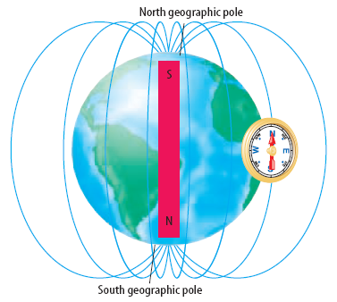
The earth is like a giant magnet!
The nickel iron core of the earth gives the earth a magnetic field much like a bar magnet.

Slide 27
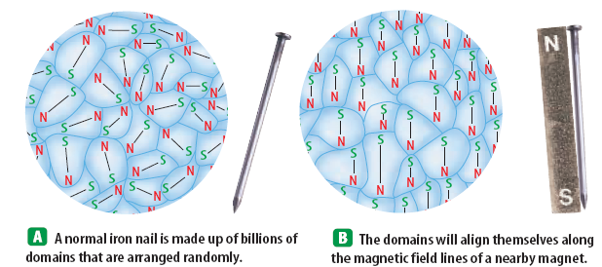
What are magnetic domains?
Magnetic substances like iron, cobalt, and nickel are composed of small areas where the groups of atoms are aligned like the poles of a magnet. These regions are called domains.
All of the domains of a magnetic substance tend to align themselves in the same direction when placed in a magnetic field. These domains are typically composed of billions of atoms.

Slide 28
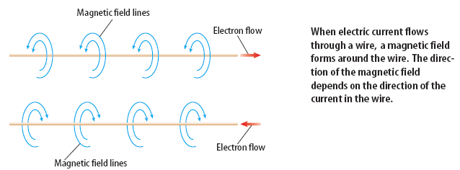
Electricity and Magnetism – how are they related?
When an electric current passes through a wire a magnetic field is formed.

Slide 29
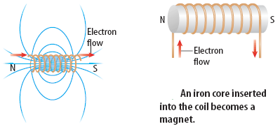
What is an electromagnet?
When an electric current is passed through a coil of wire wrapped around a metal core, a very strong magnetic field is produced. This is called an electromagnet.

Slide 30
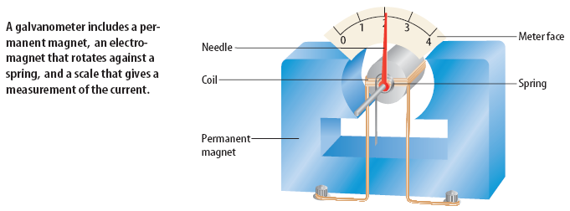
What is a galvanometer?
A galvanometer is an electromagnet that interacts with a permanent magnet. The stronger the electric current passing through the electromagnet, the more is interacts with the permanent magnet.
Galvanometers are used as gauges in cars and many other applications.
The greater the current passing through the wires, the stronger the galvanometer interacts with the permanent magnet.

Slide 31
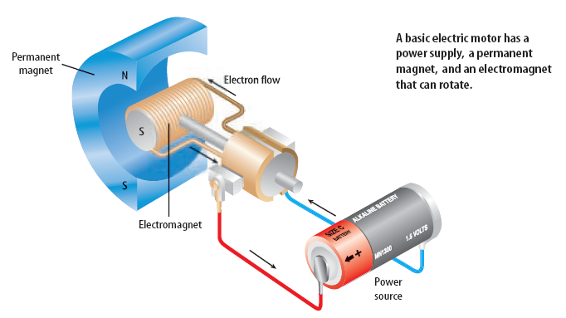
What are electric motors?
An electric motor is a device which changes electrical energy into mechanical energy.

Slide 32
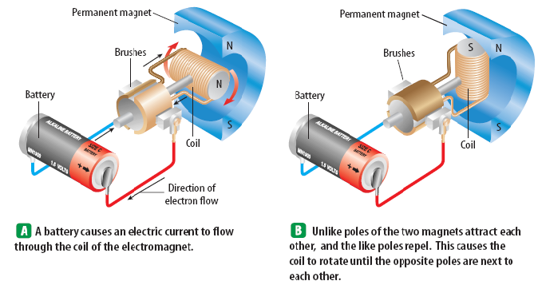
How does an electric motor work?
Go to the next slide →

Slide 33
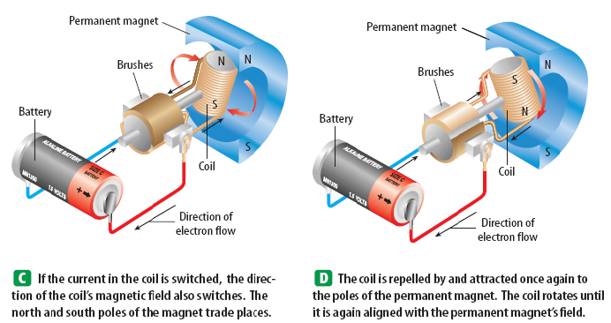
Simple as that!!

Slide 34
We have seen how electricity can produce a magnetic field, but a magnetic field can also produce electricity! How?
What is electromagnetic induction?
Moving a loop of wire through a magnetic field produces an electric current. This is electromagnetic induction.
A generator is used to convert mechanical energy into electrical energy by electromagnetic induction.
Carefully study the next diagrams:

Slide 35
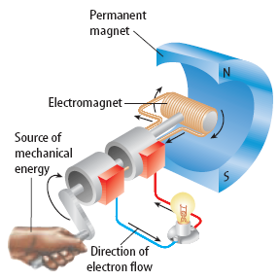
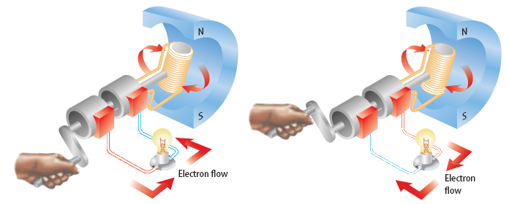

Slide 36
Direct current versus alternating current –
AC vs DC : What’s the difference?
Direct current is electrical current which comes from a battery which supplies a constant flow of electricity in one direction.
Alternating current is electrical current which comes from a generator. As the electromagnet is rotated in the permanent magnet the direction of the current alternates once for every revolution.

Slide 37
Go to this website and click the button for DC then for AC to visually see the difference between the two.
You can see that the DC source is a battery – current flows in one direction. The AC source is the generator and the current alternates once for each revolution.

