Slide 1
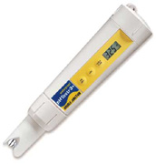
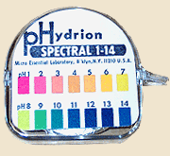
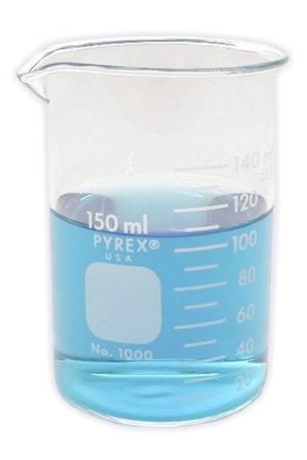
Slide 1 What is pH?

Slide 2
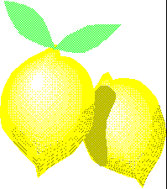
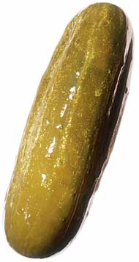
Acids and Bases Slide 2
Some of our favorite foods make our tongue curl up because they are SOUR.

Slide 3
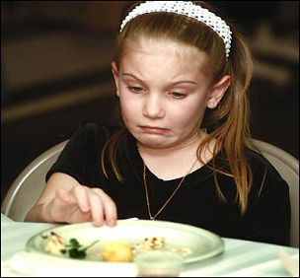
Bitter! Slide 3
Some foods have a “bite” of their own because they’re somewhat bitter.
WHY?

Slide 4
Acidic/Basic Slide 4
There is a scientific reason for this:
These foods are either acidic or basic.
Other substances besides foods have these characteristics.

Slide 5
Acids and Bases Slide 5
Chemicals may be classed as acids or bases.
Substances that are neither acids nor bases are neutral.
pH measures how acidic or basic a solution is.

Slide 6
Acids Slide 6
Often taste sour
Strong acids can burn skin & eyes
Strong acids can dissolve metals
Examples:
Lemon juice
Vinegar
Car battery acid (dangerous!)

Slide 7
Bases Slide 7
Can taste bitter, sweetish, or salty
Strong bases can burn skin & eyes
Bases react more easily with protein than with metal; they are often used for cleaning
Examples:
Milk
Baking soda
Soap
Drain cleaner (dangerous!)

Slide 8
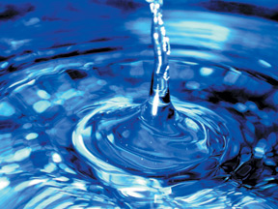
Slide 8
Some substances are not really an acid or a base: For example, pure water

Slide 9
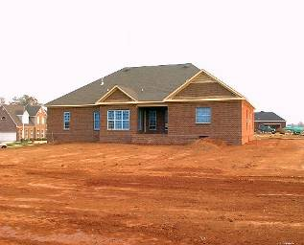
Most Substances: Slide 9
Can be identified as either acidic or basic
Like the soil in our backyard.

Slide 10
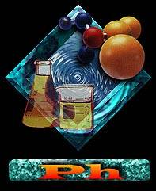
pH Slide 10
A special name is given to the acid or base characteristic that a substance has:
It is called: pH
“p” stands for potential and “H” stands for hydrogen; hence, the potential of a substance to attract hydrogen ions

Slide 11
How Do We Measure pH? Slide 11
We measure pH by using special strips of paper called pH paper
or Litmus paper

Slide 12
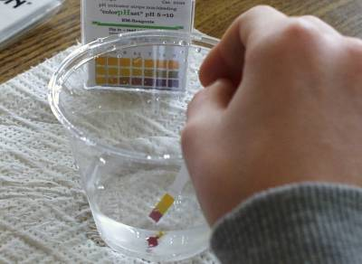
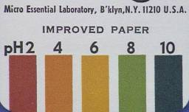
How Does It Work? Slide 12
The paper is treated with chemicals that change color to show the pH.
When the paper touches the substance being tested, it turns a specific color to tell if the substance is an acid or a base.
Acid Neutral Basic

Slide 13
The pH Scale Slide 13
pH scale ranges from 0 -14
pH 7 is neutral; neither acid nor base
Pure water is pH 7
Low pH (0-6.9) = acid
High pH (7.1-14) = base
The closer to the ends of the scale, the stronger the solution is

Slide 14
Acid Slide 14
Any substance which has a pH of value of less than 7 is considered an acid
0--------------7---------------14
Acid Neutral Base

Slide 15
Base Slide 15
Any substance which has pH value greater than 7 is a base
0--------------7---------------14
Acid Neutral Base

Slide 16
pH 7 Slide 16
A pH of 7 is called neutral it’s neither acid nor base.
0------------7------------14
Acid Neutral Base

Slide 17
To Use pH/Litmus Paper Slide 17
Place the edge of the pH paper into the mixture.
Observe the color change of the pH paper
Match the resulting color to the colors listed on the outside of the pH paper package.
The colors will match with a correlated pH number.
The number next to the color is the pH value of the sample.

Slide 18
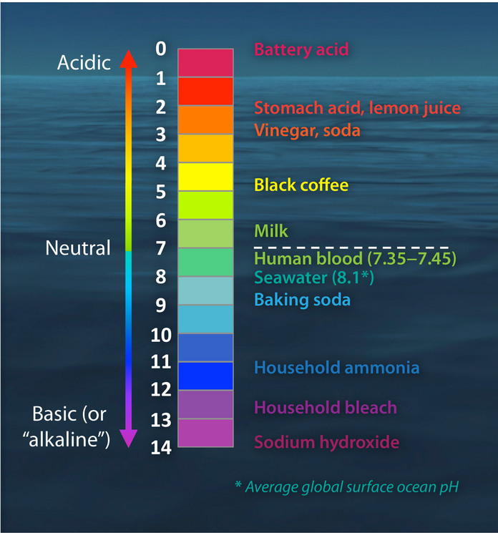
Acidic or Basic Slide 18
If the number is less than 7 the substance is acidic
If the number is more than 7 the substance is basic

Slide 19
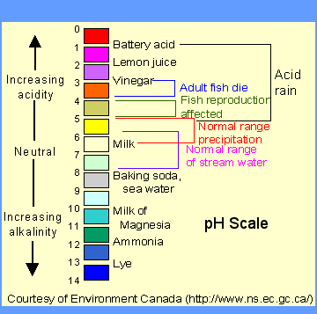
The pH Scale Slide 19

Slide 20
The pH Scale Slide 20
Each pH unit is 10 times as large as the previous one
A change of 2 pH units means 100 times more basic or acidic
x10
x100

Slide 21
The pH Scale Slide 21
Careful measurement is important
A mistake of one pH unit means 10 times too much or too little!
x10
x100

Slide 22
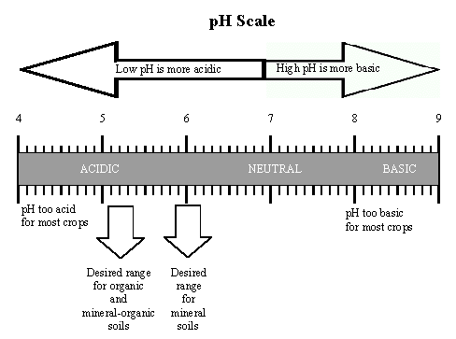
Why is pH important? Slide 22
Fish can’t live if the pH is too high or too low
Soil has to be in a certain pH range for plants to grow and stay healthy.

Slide 23
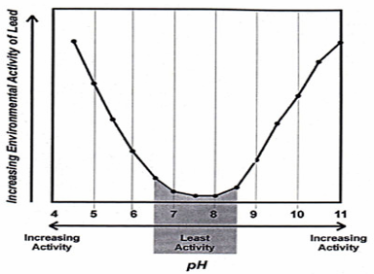
pH and People Slide 23
Water that has too high or low pH contains harmful dissolved chemicals.
Water plant operators keep a careful watch on the pH of our drinking water, to keep it safe.
Notes:
Heavy metals, such as lead, react to changes in pH. Environmental regulations require drinking water to remain within a specific pH range to prevent lead and other metals from dissolving out of pipes and containers and entering the water.

Slide 24
Slide 24

